Slide 1
MOOSE-Chem: Large Language Models for Rediscovering Unseen Chemistry Scientific Hypotheses
Zonglin Yang

Slide 2
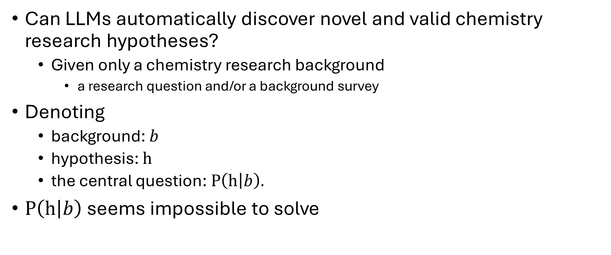
Central question
Can LLMs automatically discover novel and valid chemistry research hypotheses?
Given only a chemistry research background
a research question and/or a background survey
Denoting
background: $b$
hypothesis: $h$
the central question: $P\left(h | b\right).$
$P\left(h | b\right)$ seems impossible to solve
Notes:
The research question can be on any chemistry domain

Slide 3
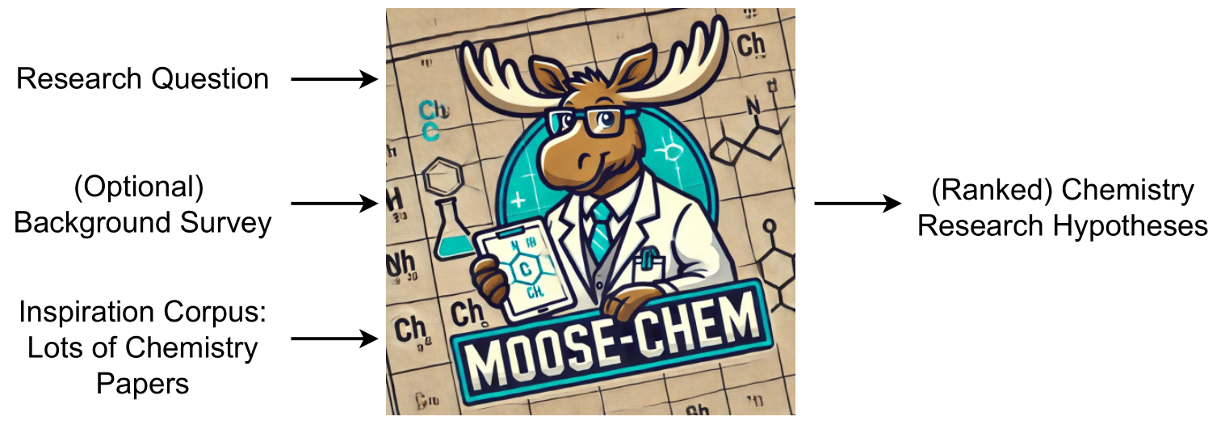
Input / Output of MOOSE-Chem
Research Background

Slide 4
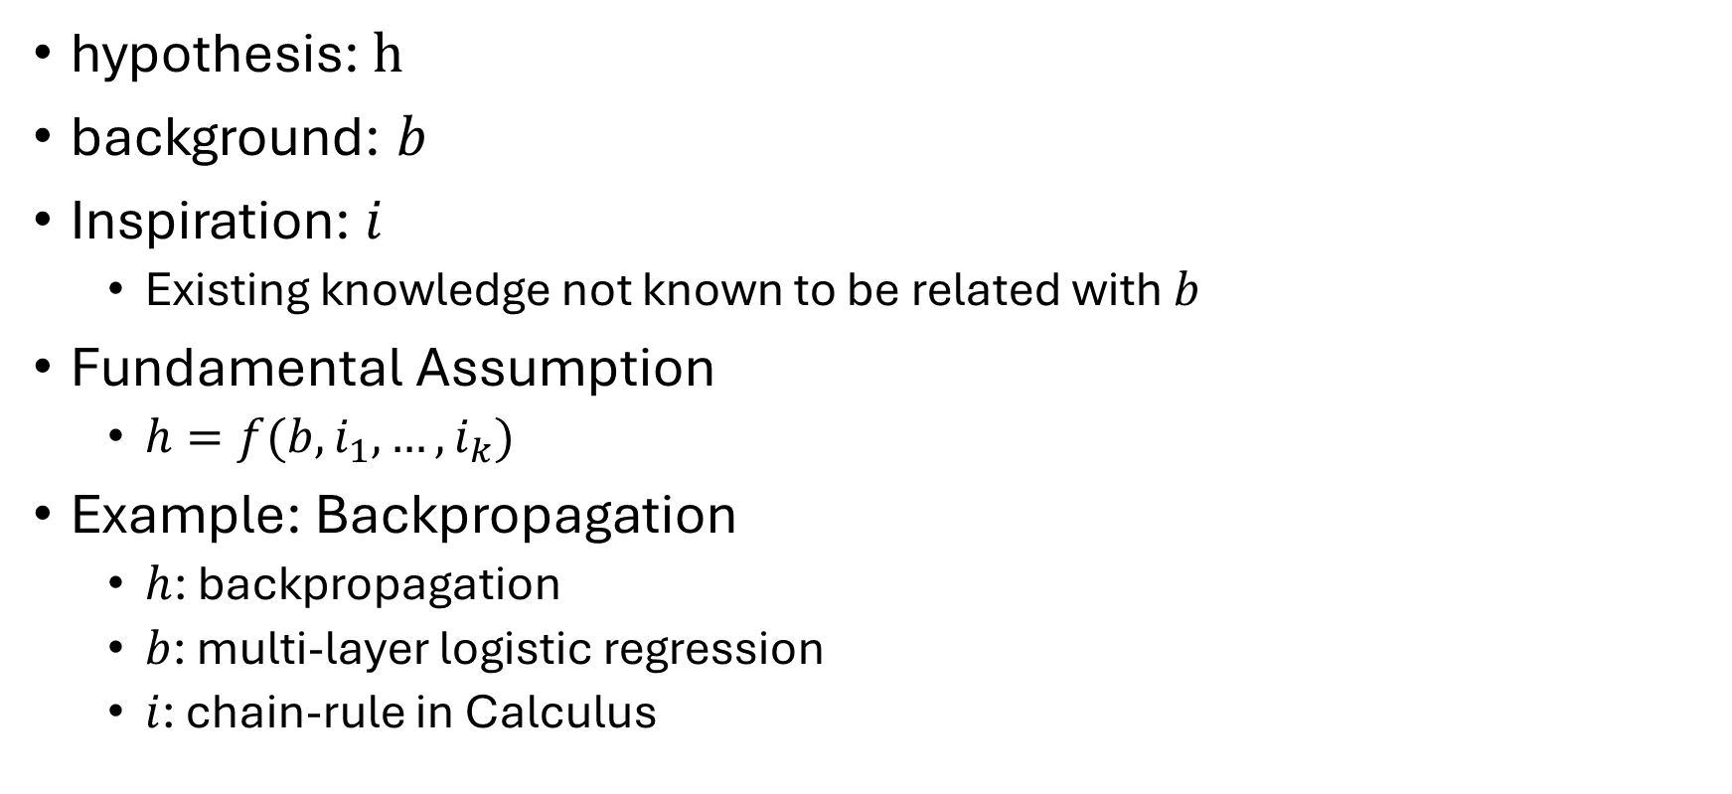
Fundamental assumption and decomposition
hypothesis: $h$
background: $b$
Inspiration: $i$
Existing knowledge not known to be related with $b$
Fundamental Assumption
$h=f(b, i_{1},…,i_{k})$
Example: Backpropagation
$h$: backpropagation
$b$: multi-layer logistic regression
$i$: chain-rule in Calculus
Notes:
Extensive discussions with chemistry experts
where $k$ $≤3, and i in I$

Slide 5
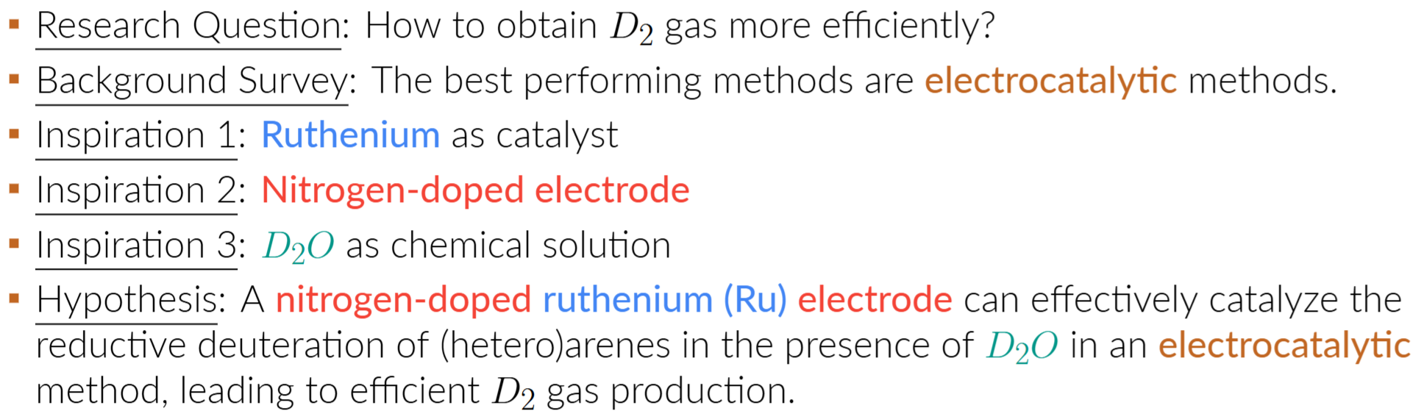
An Example Publication (<Nature>, 2024)

Slide 6
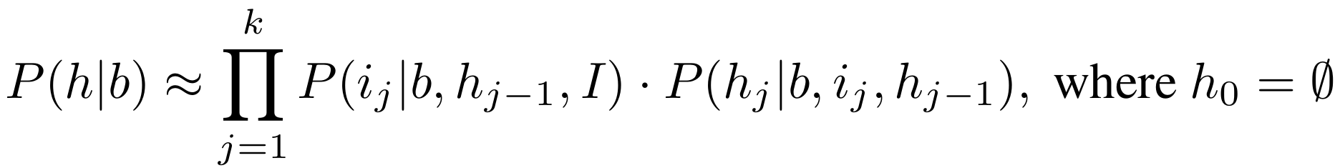
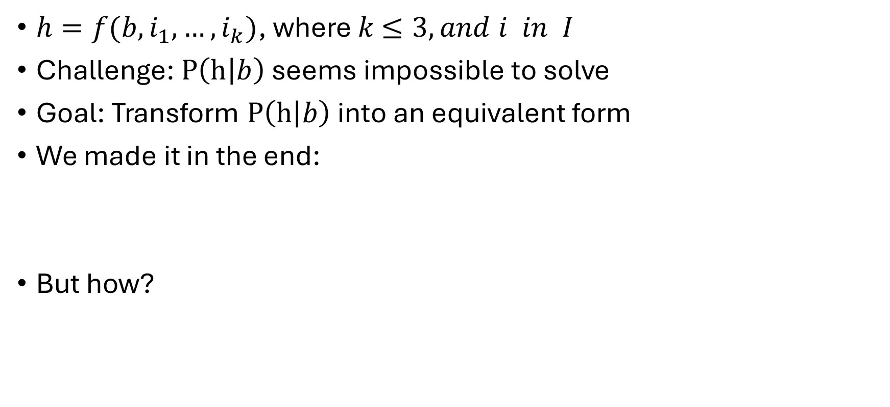
Fundamental assumption and decomposition
$h=f(b, i_{1},…,i_{k})$, where $k$ $≤3, and i in I$
Challenge: $P\left(h | b\right)$ seems impossible to solve
Goal: Transform $P\left(h | b\right)$ into an equivalent form
We made it in the end:
But how?
Fundamental Assumption
Notes:
, where each step is practical and executable

Slide 7
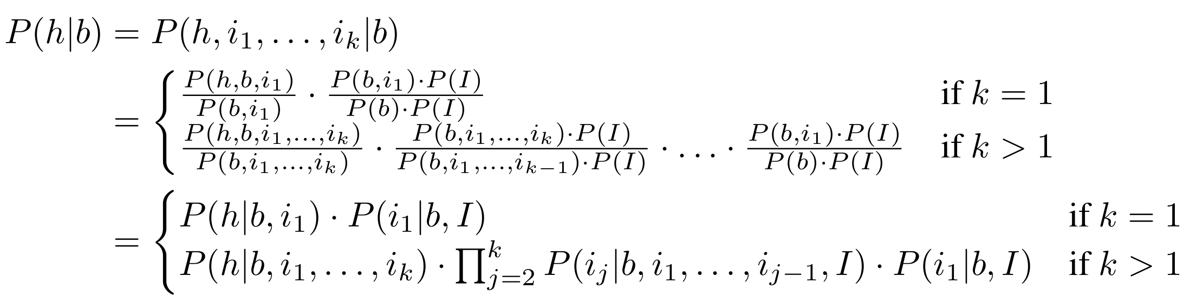
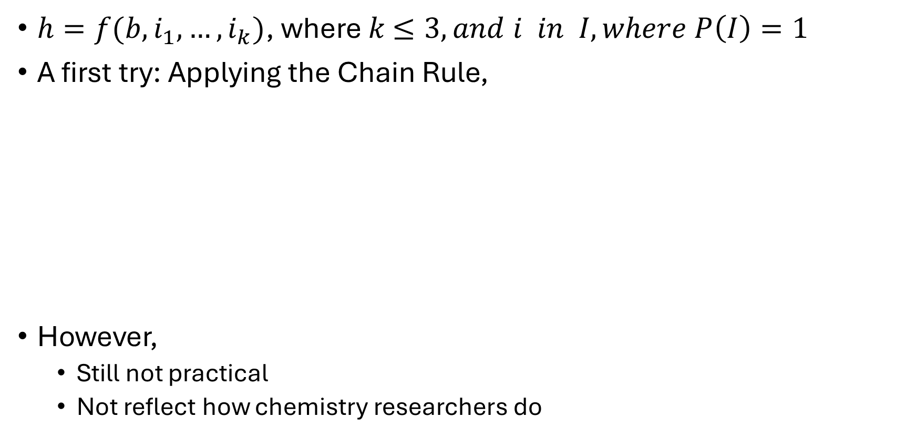
Fundamental assumption and decomposition
$h=f(b, i_{1},…,i_{k})$, where $k$ $≤3, and i in I, where P\left(I\right)=1$
A first try: Applying the Chain Rule,
However,
Still not practical
Not reflect how chemistry researchers do
Step by Step!

Slide 8
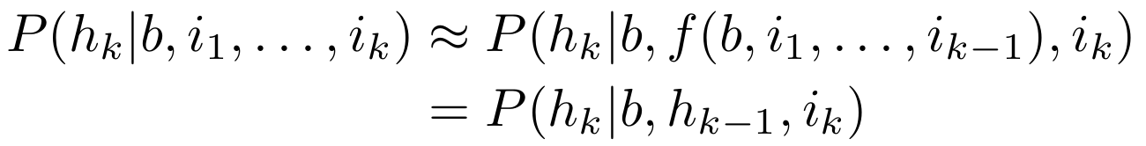
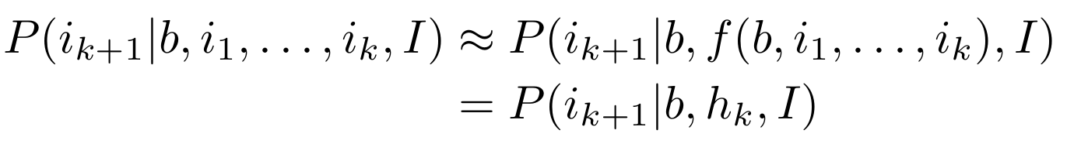
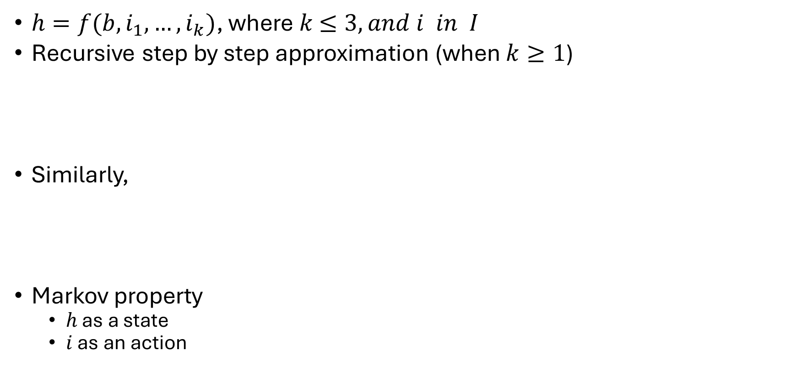

Not Practical: $P(h\left|b,i_{1}, …,i_{k}\right)$ and $P(i_{j+1}|b,i_{1},…,i_{j},I)$
$h=f(b, i_{1},…,i_{k})$, where $k$ $≤3, and i in I$
Recursive step by step approximation (when $k≥1$)
Similarly,
Markov property
$h$ as a state
$i$ as an action

Slide 9
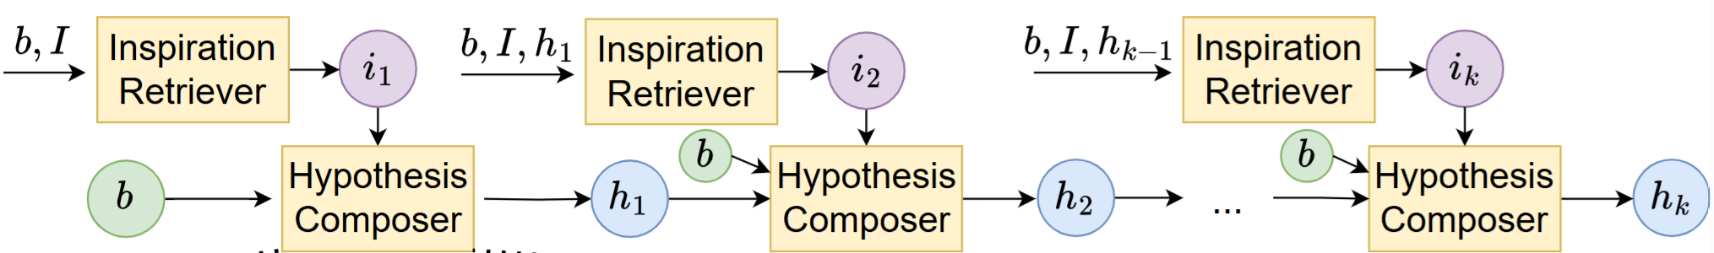
Markov Property in Scientific Discovery

Slide 10
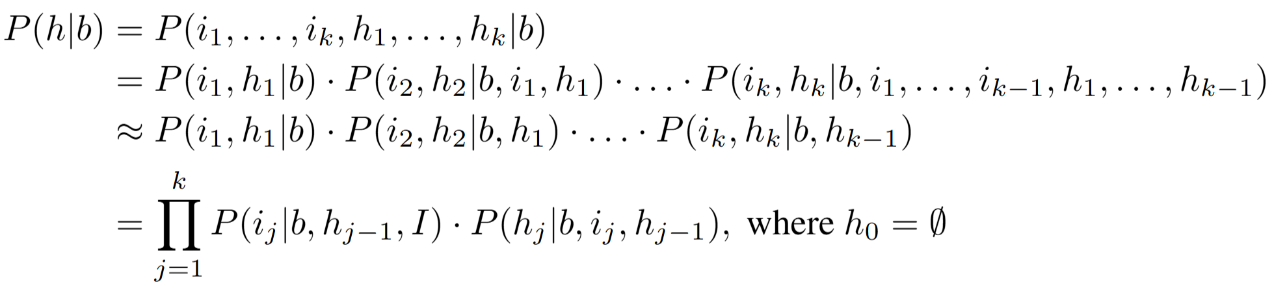
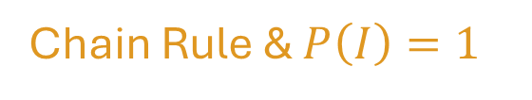
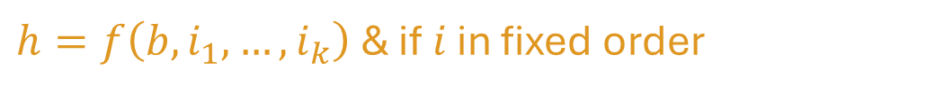

Final Proof: Decomposition of $P\left(h | b\right)$
$h=f\left(b, i_{1},…,i_{k}\right)$ & if $i$ in fixed order
Chain Rule
Markov Property
Chain Rule & $P\left(I\right)=1$
Notes:
The seemingly impossible question $P\left(h | b\right)$
→ many smaller, more practical and executable questions

Slide 11
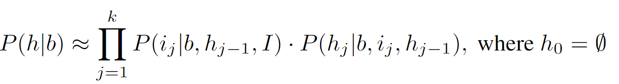
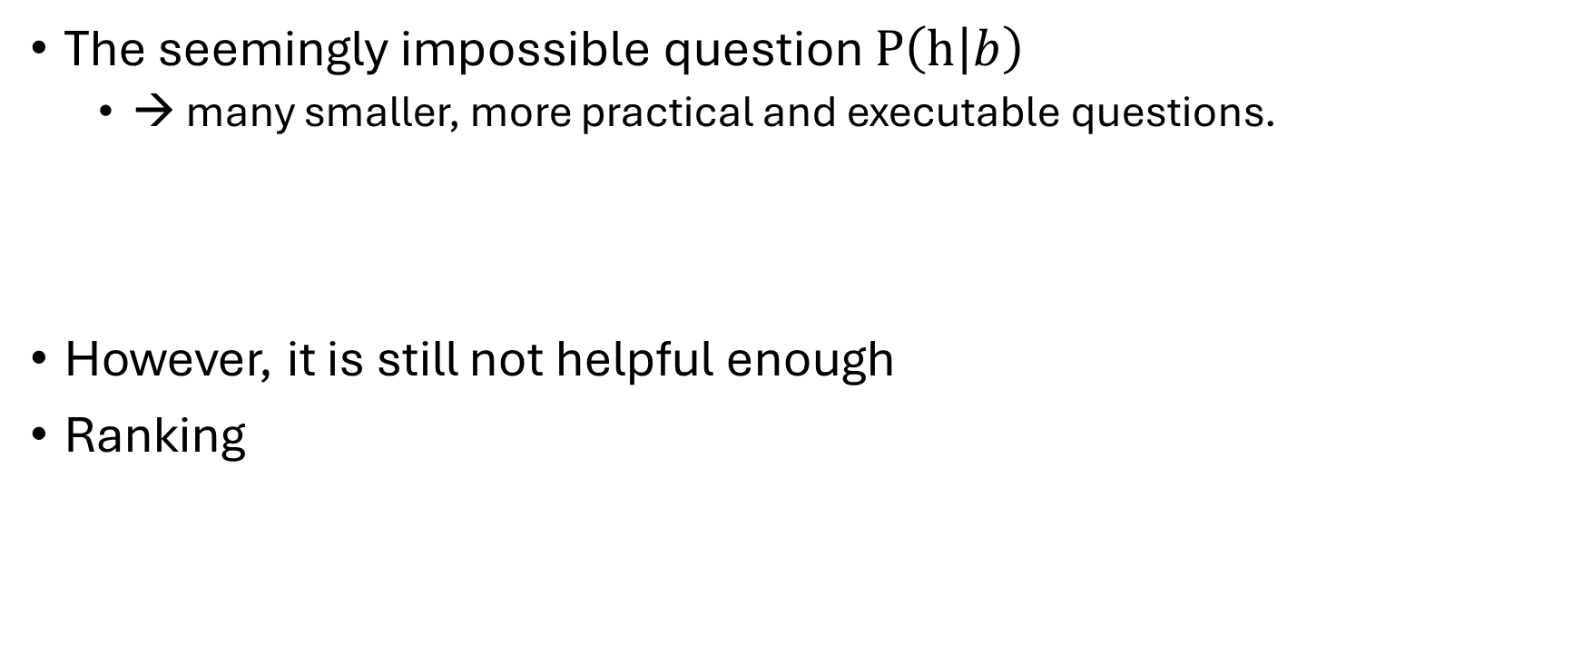
Fundamental assumption and decomposition
The seemingly impossible question $P\left(h | b\right)$
→ many smaller, more practical and executable questions.
However, it is still not helpful enough
Ranking
Notes:
Lots of $h$ can be generated with LLMs
Wet-lab experiments to verify each $h$ take lots of time and cost

Slide 12
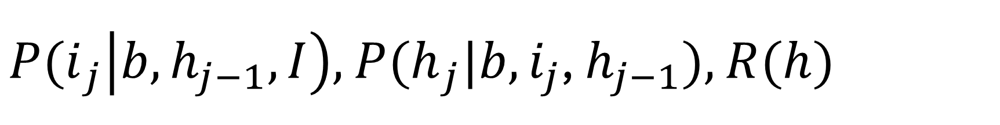
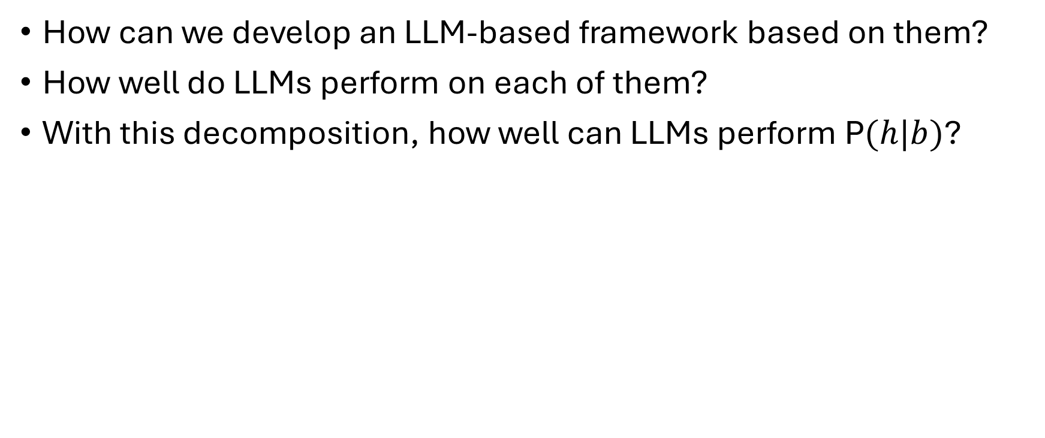
${P(i}_{j}\left|b,h_{j−1},I\right),$ ${P(h}_{j}|b, i_{j}$, $h_{j−1}),$ $R(h)$
How can we develop an LLM-based framework based on them?
How well do LLMs perform on each of them?
With this decomposition, how well can LLMs perform P$(h|b)$?
Notes:
The third question is our central question: How far is us with a research copilot that can automatically propose novel and valid chemistry hypotheses, given only a chemistry research background, without limitation on the domain of the background?

Slide 13
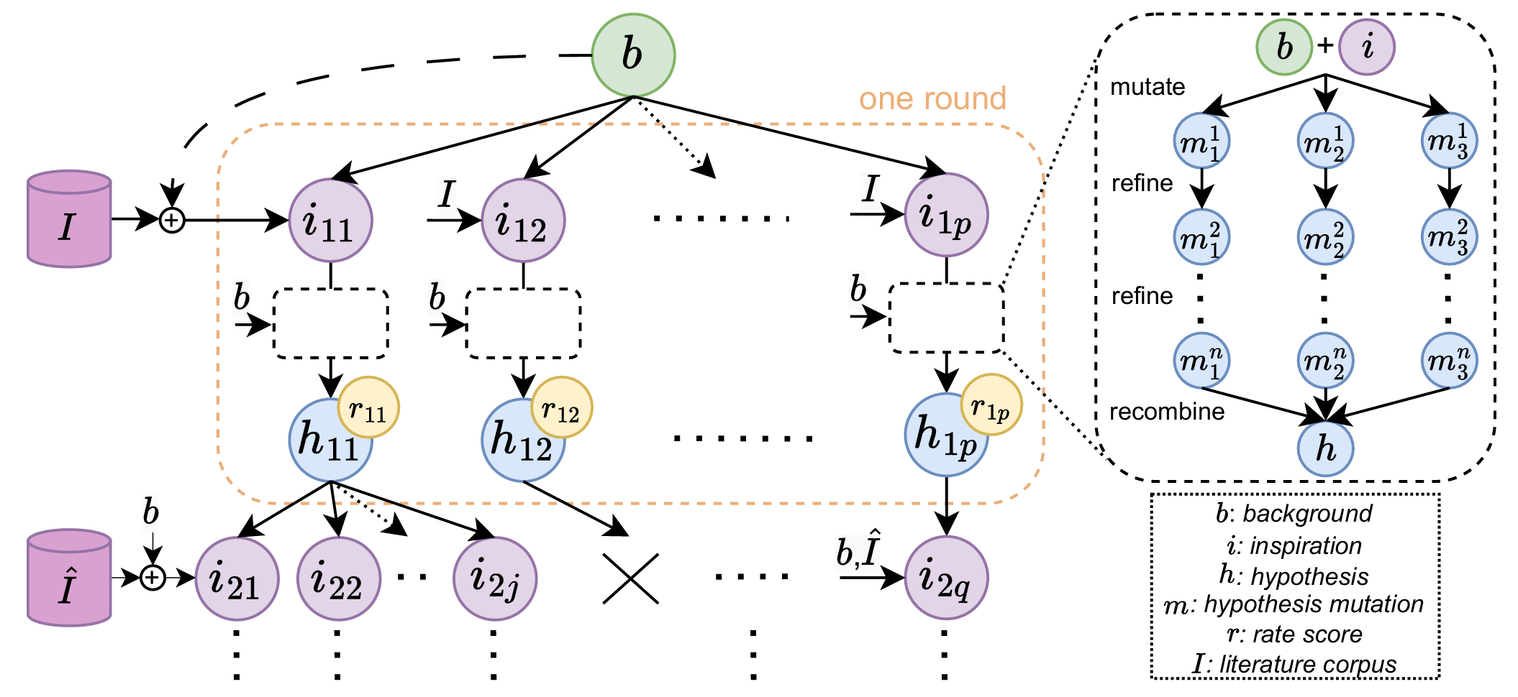
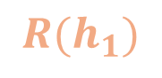
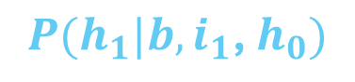
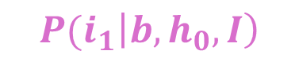
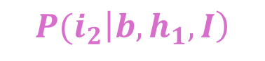
$${P(i}_{1}\left|b,h_{0},I\right)$$
$$R(h_{1})$$
$${P(h}_{1}|b, i_{1}\text{, }h_{0})$$
$${P(i}_{2}\left|b,h_{1},I\right)$$
Notes:
To understand “How well do LLMs perform on them?”, we need a benchmark.

Slide 14

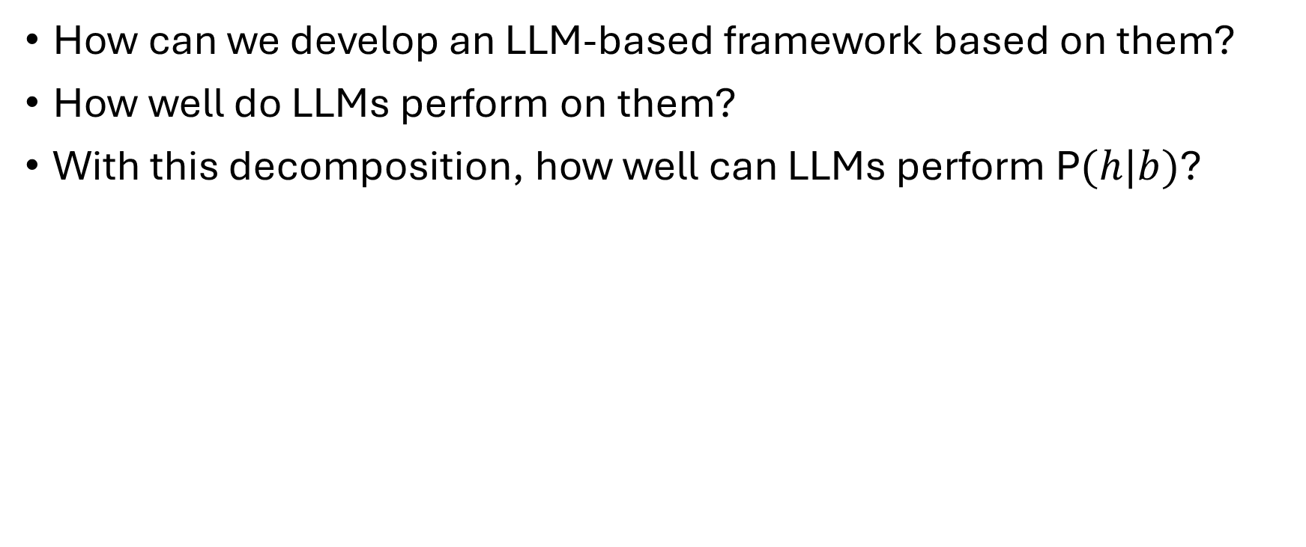
${P(i}_{j}\left|b,h_{j−1},I\right),$ ${P(h}_{j}|b, i_{j}$, $h_{j−1}),$ $R(h)$
How can we develop an LLM-based framework based on them?
How well do LLMs perform on them?
With this decomposition, how well can LLMs perform P$(h|b)$?
It needs groundtruth annotation of
$b$, $i$, and $h$.
Notes:
The third question is our central question: How far is us with a research copilot that can automatically propose novel and valid chemistry hypotheses, given only a chemistry research background, without limitation on the domain of the background?

Slide 15
The Benchmark
51 chemistry papers
Published on Nature, Science, or a similar level
Published in 2024, and only be available online in 2024
Collected by several chemistry PhD students
Break each paper into:
Background question
Background survey
Inspirations
Existing Papers as Inspirations
Hypothesis

Slide 16
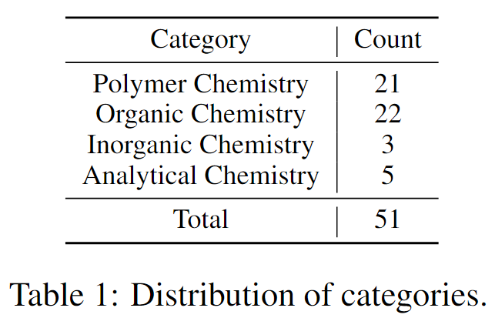
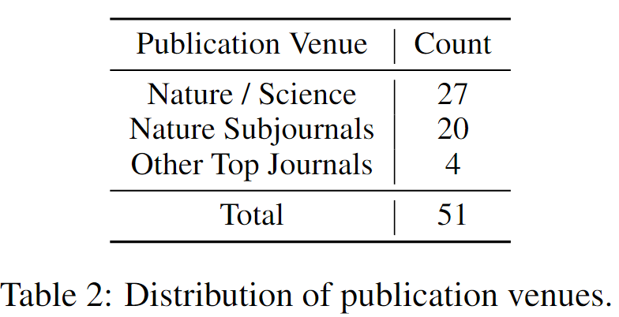
The Benchmark

Slide 17
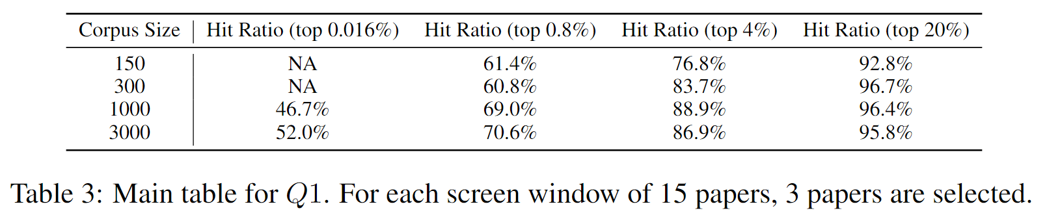
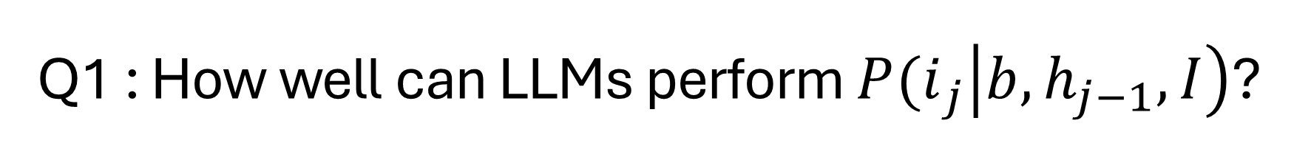
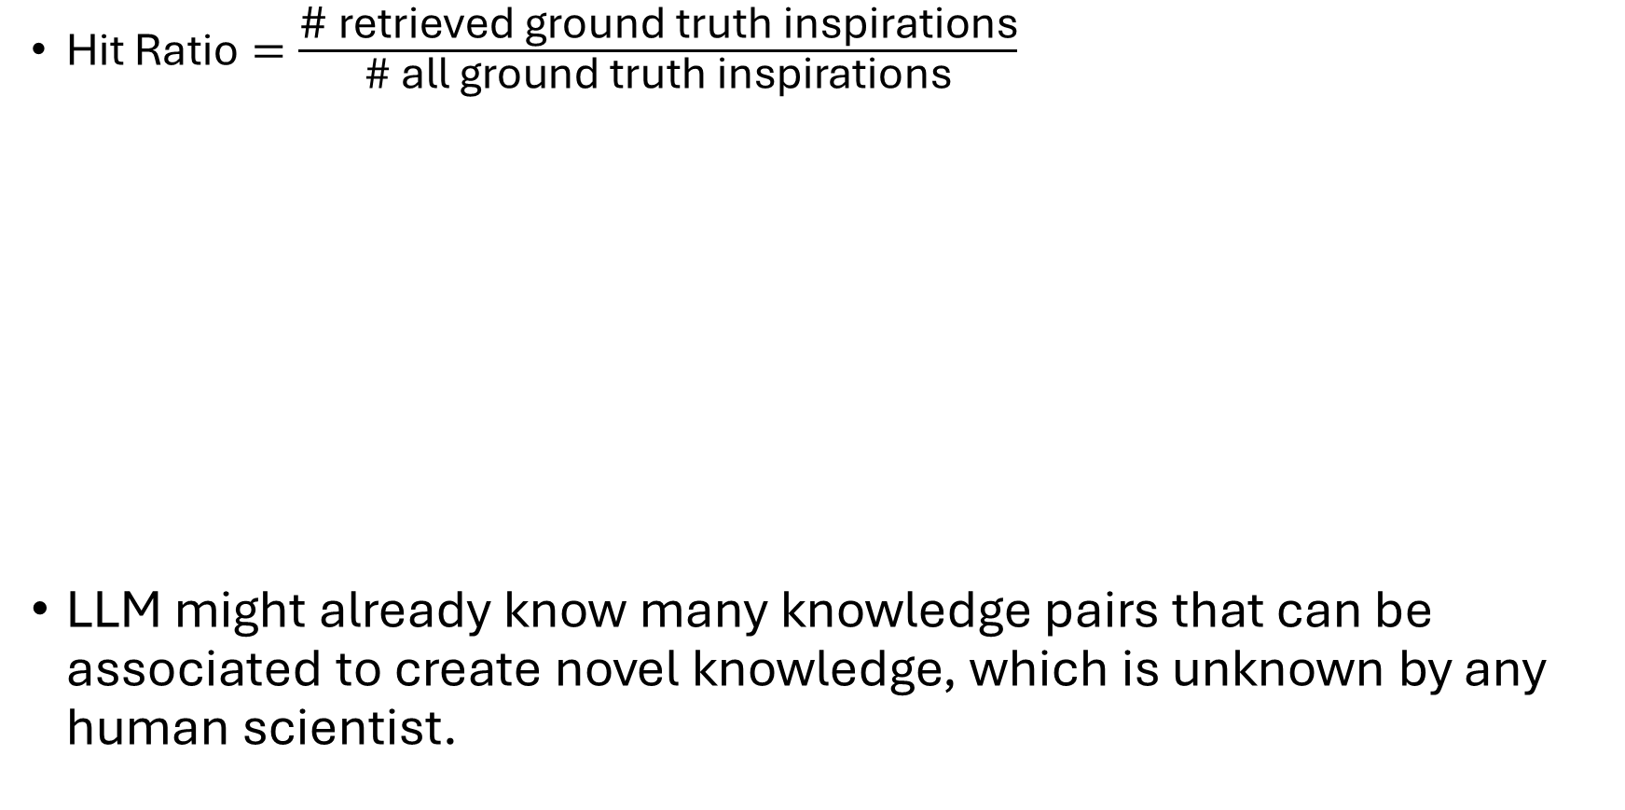
Q1 : How well can LLMs perform ${P(i}_{j}\left|b,h_{j−1},I\right)$?
$\text{Hit} \text{Ratio}=\frac{\text{\# }\text{retrieved} \text{ground} \text{truth} \text{inspirations}}{\text{\# }\text{all} \text{ground} \text{truth} \text{inspirations}}$
LLM might already know many knowledge pairs that can be associated to create novel knowledge, which is unknown by any human scientist.
15 inspiration candidates
LLM
3 inspiration candidates
Bold Assumption
Notes:
Whether LLM can identify inspiration papers which are unknown to be able to associate with the background (or at least unknown to associate in a certain way) but in fact can associate with the background to create novel knowledge?

Slide 18
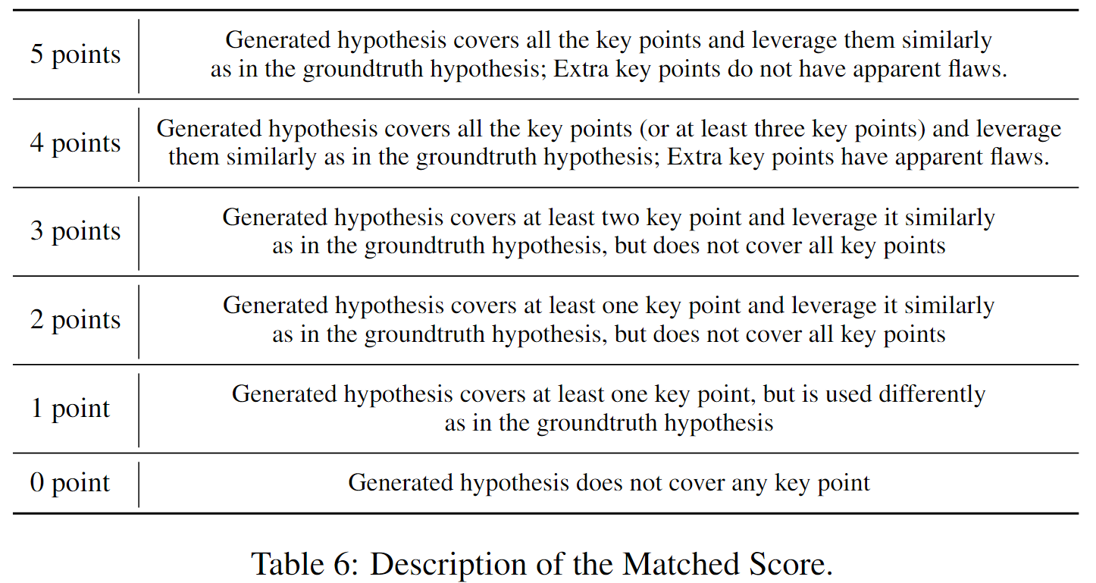
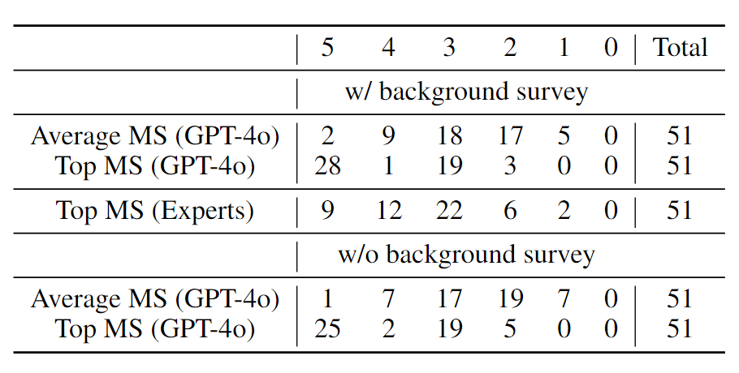
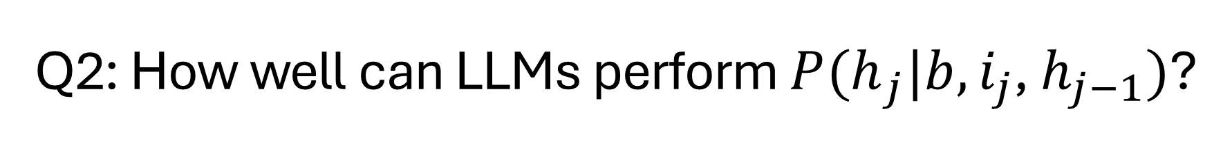
Q2: How well can LLMs perform ${P(h}_{j}|b, i_{j}$, $h_{j−1})$?
Given only known knowledge, whether LLM can reason to unknown knowledge that has high probability to be valid?

Slide 19
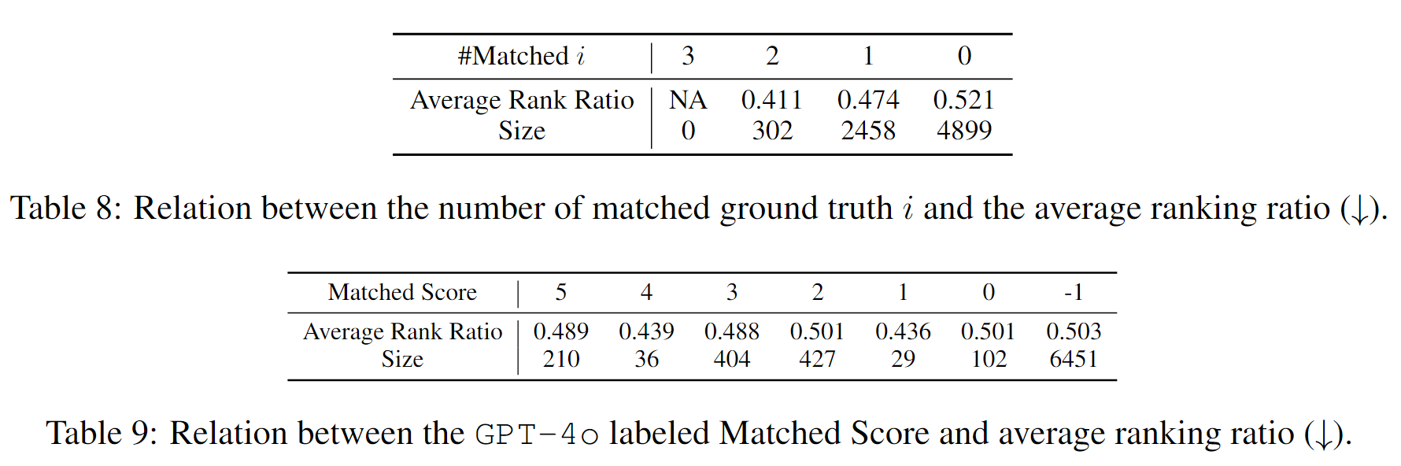

Q3: How well can LLMs perform $R(h)$?
whether LLMs can select high-quality h to rank them higher?

Slide 20
${P(i}_{j}\left|b,h_{j−1},I\right),$ ${P(h}_{j}|b, i_{j}$, $h_{j−1}),$ $R(h)$
How can we develop an LLM-based framework based on them?
How well do LLMs perform on them?
With this decomposition, how well can LLMs perform P$(h|b)$?
Notes:
The third question is our central question: How far is us with a research copilot that can automatically propose novel and valid chemistry hypotheses, given only a chemistry research background, without limitation on the domain of the background?

Slide 21
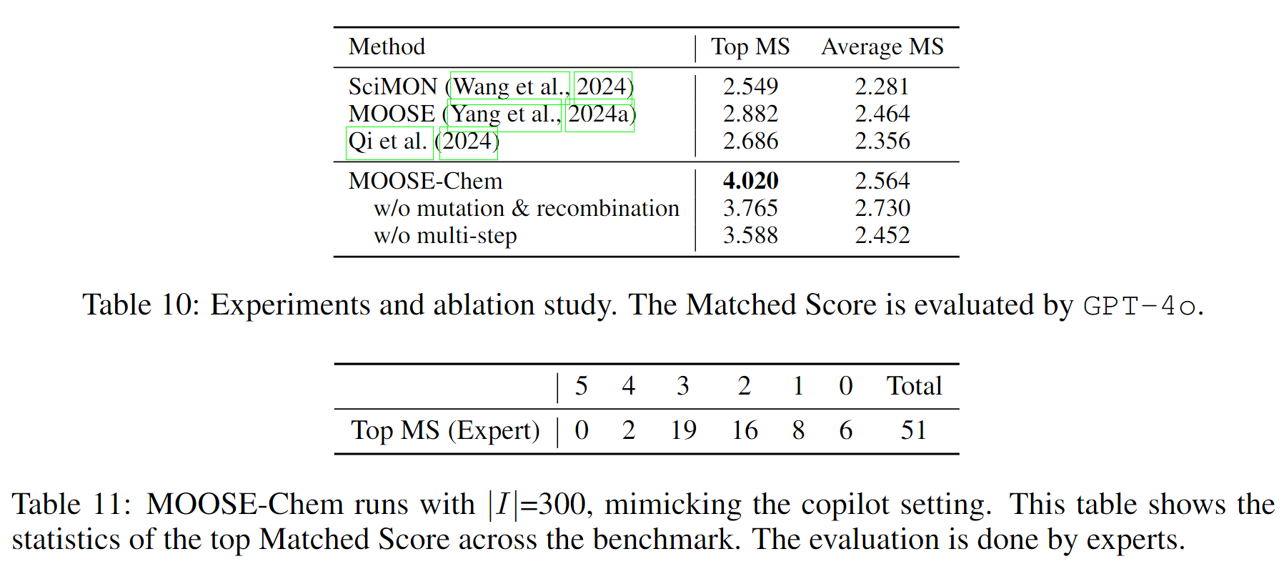
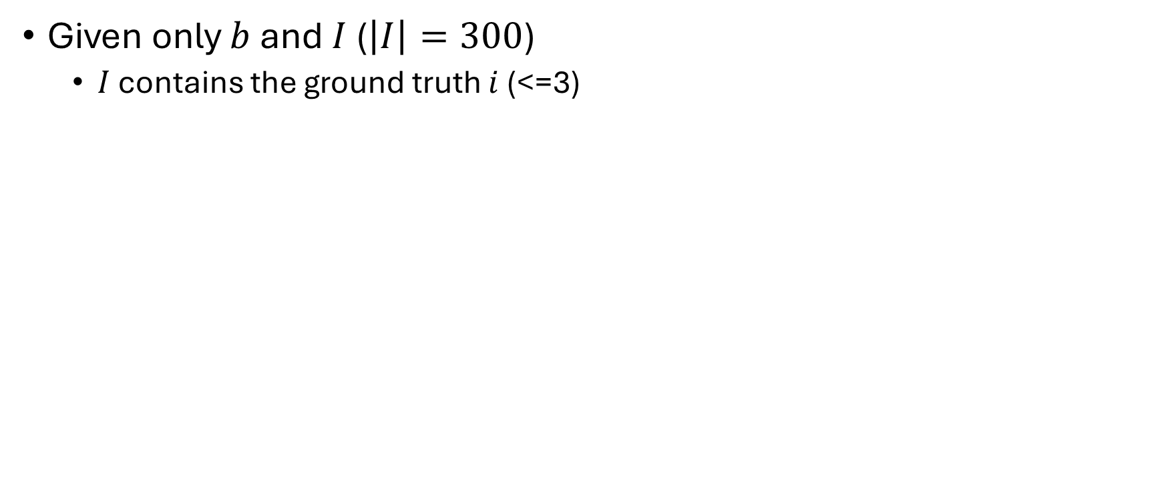
Runs MOOSE-Chem in real copilot setting
Given only $b$ and $I$ ($\left|I\right|=300$)
$I$ contains the ground truth $i$(<=3)

Slide 22
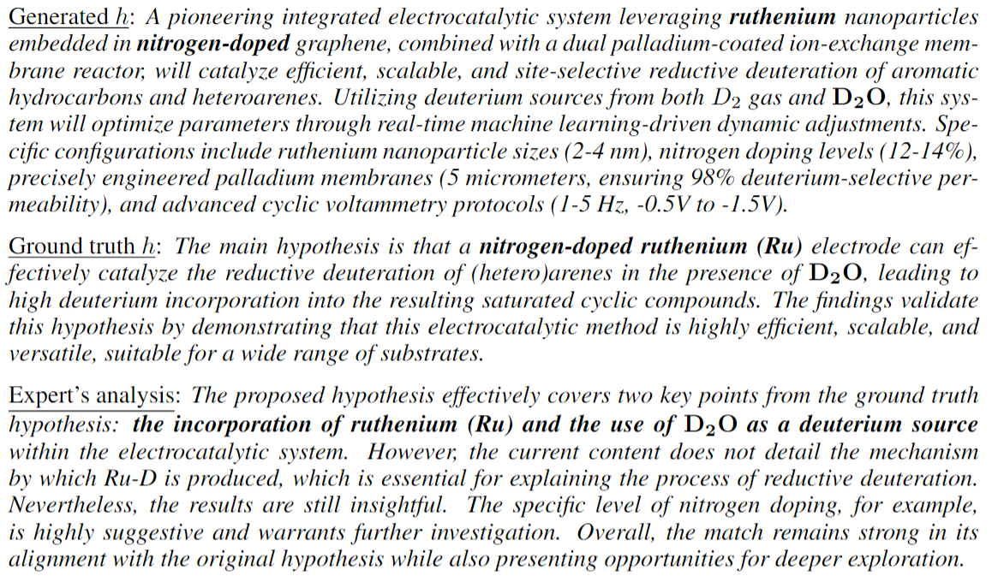
Case study

Slide 23
Thanks!

Slide 24


Future Work: Automated Scientific Discovery
DEER
?
MOOSE
MOOSE-Chem

